Slide 1
Assembly Programming
Abhishek Bhattacharjee
Topics
Introduction to Assembly Programming
x86 assembly

Slide 2
Review

Slide 3
Decimal to IEEE Floating Point
5.625
In binary
101.101 → 1.01101 x 2²
Exponent field has value 2
add 127 to get 129
Exponent is 10000001
Mantissa is 01101
Sign bit is 0
0 10000001 0110100000000000000000

Slide 4
2’s Complement Addition & Subtraction
Addition = binary addition, ignore carry out
Subtraction = invert subtrahend and add
4 – 2 = 4 + -2
-7 1001
+ 5 0101
----------
-2 1110
-5 1011
+ -2 1110
------------
-7 11001
4 0100
+ -2 1110
------------
2 0010

Slide 5
2’s Complement Overflow
What happens when overflow occurs with 2’s complement?
Need one extra bit so sign bit will be wrong
How to detect?
Adding 2 positive numbers ➔ negative result
Adding 2 negative numbers ➔ positive result
6 0110
+ 5 0101
-----------
-5 1011
-6 1010
+ -6 1010
------------
4 0100

Slide 6
Multiplication Algorithm
1011
x 101
------
1011
0000
1011
------
110111
(multiplicand x 1) shift left 0
(multiplicand x 0) shift left 1
(multiplicand x 1) shift left 2

Slide 7
Algorithm
result = 0
If LSB of multiplier = 1, add multiplicand to result else, add 0 to result
Shift multiplicand left by 1 bit (fill LSB with 0)
Shift multiplier right by 1 bit (fill MSB with 0)
If multiplier > 0, go to 1
Stop
We only need to know how to add and shift in order to multiply

Slide 8
Sign extension
Signed integer | 4-bit representation | 8-bit representation | 16-bit representation
+1 | 0001 | 00000001 | 0000000000000001
-1 | 1111 | 11111111 | 1111111111111111

Slide 9
Assembly Programming
Brief tour through assembly language programming
Why?
Machine interface: where software meets hardware
To understand how the hardware works, we have to understand the interface that it exports
Why not binary language?
Much easier for humans to read and reason about
Major differences:
Human readable language instead of binary sequences
Relative instead of absolute addresses

Slide 10
Programming Meets Hardware
#include <stdio.h>
int main() {
int x, y, temp;
x=1; y=2;
temp =x; x=y; y=temp;
printf("%d %d %d\n",x,y,temp);
}
High-Level Language Program
Compiler
movl $1, -8(%ebp)
movl $2, -12(%ebp)
movl -8(%ebp), %eax
movl %eax, -16(%ebp)
movl -12(%ebp), %eax
movl %eax, -8(%ebp)
movl -16(%ebp), %eax
movl %eax, -12(%ebp)
movl -16(%ebp), %eax
movl %eax, 12(%esp)
movl -12(%ebp), %eax
movl %eax, 8(%esp)
movl -8(%ebp), %eax
movl %eax, 4(%esp)
Assembly Language Program
Assembler
ISA
Machine Language Program
7f 45 4c 46 01 01 01
00 00 00 00 00 00 00
00 00 02 00 03 00 01
00 00 00 f0 82 04 08
34 00 00 00 c4 0c 00
00 00 00 00 00 34 00

Slide 11
IA32
There are many different assembly languages because they are processor-specific
IA32 (x86)
x86-64 for new 64-bit processors
IA-64 radically different for Itanium processors
PowerPC
MIPS
We will focus on IA32 because you can generate and run on iLab machines (as well as your own PC/laptop)
IA32 is also dominant in the market although smart phone, eBook readers, etc. are changing this

Slide 12
Aside About Implementation of x86
About 30 years ago, the instruction set actually reflected the processor hardware
E.g., the set of registers in the instruction set is actually what was present in the processor
As hardware advanced, industry faced with choice
Change the instruction set: bad for backward compatibility
Keep the instruction set: harder to exploit hardware advances
Example: many more registers but only small set introduced circa 1980
Starting with the P6 (PentiumPro), IA32 actually got implemented by Intel using an “interpreter” that translates IA32 instructions into a simpler “micro” instruction set

Slide 13
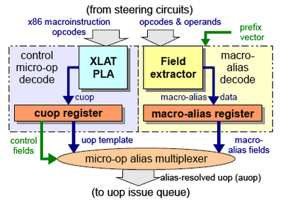
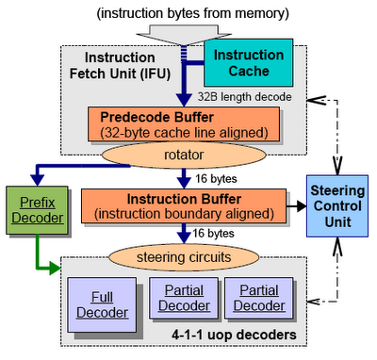
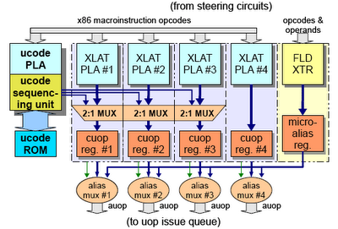
P6 Decoder/Interpreter

Slide 14
Assembly Programmer’s View
CPU
Memory
Control
Logic
Addresses
ALU
(OS code & data)
Object Code
Program Data
Data
PC
Condition
Codes
Instructions
Registers

Slide 15
Memory
Memory
Storage
CPU
00
01
02
03
04
05
06
07
08
09
0A
0B
0C
0D
0E
0F
00101100
10001000
11111111
01010101
00000000
11000001
00000000
11111001
11111000
00110000
00000000
00000000
00000000
11000011
00011001
00000000
Address
Command: R/W
Data
Addresses

Slide 16
Memory Access: Read
Memory
Storage
CPU
00
01
02
03
04
05
06
07
08
09
0A
0B
0C
0D
0E
0F
00101100
10001000
11111111
01010101
00000000
11000001
00000000
11111001
11111000
00110000
00000000
00000000
00000000
11000011
00011001
00000000
03
R
01010101
Addresses

Slide 17
Memory Access: Write
Memory
Storage
CPU
00
01
02
03
04
05
06
07
08
09
0A
0B
0C
0D
0E
0F
00101100
10001000
11111111
01010101
00000000
11000001
00000000
11111001
11111000
00110000
00000000
00000000
00000000
11000011
00011001
00000000
04
W
01010101
Addresses

Slide 18
Memory Access: Write
Memory
Storage
CPU
00
01
02
03
04
05
06
07
08
09
0A
0B
0C
0D
0E
0F
00101100
10001000
11111111
01010101
01010101
11000001
00000000
11111001
11111000
00110000
00000000
00000000
00000000
11000011
00011001
00000000
04
W
01010101
Addresses

Slide 19
Processor: ALU & Registers
C
C = F_{S}(A, B)
S
F includes
Arithmetic: +, -, *, /, ~, etc.
Logical: <, >, =, etc.
ALU
A
B
Registers
Name
Name
Storage
R0
R1
R2
R3
00101100
10001000
11111111
01010101
Command: R/W
Multiple Ports
Data

Slide 20
Putting It All Together
CPU
Memory
Condition Codes
Storage
Program Counter (PC)
00
01
02
03
04
05
06
07
08
09
0A
0B
0C
0D
0E
0F
00101100
10001000
11111111
01010101
01010101
11000001
00000000
11111001
11111000
00110000
00000000
00000000
00000000
11000011
00011001
00000000
ALU
Control
Logic
Addresses
Registers

Slide 21
Putting It All Together
CPU
Memory
Condition Codes
Storage
Program Counter (PC)
1
00
01
02
03
04
05
06
07
08
09
0A
0B
0C
0D
0E
0F
00101100
10001000
11111111
01010101
01010101
11000001
00000000
11111001
11111000
00110000
00000000
00000000
00000000
11000011
00011001
00000000
ALU
Control
Logic
Addresses
Registers

Slide 22
Putting It All Together
CPU
Memory
Condition Codes
Storage
Program Counter (PC)
1
00
01
02
03
04
05
06
07
08
09
0A
0B
0C
0D
0E
0F
00101100
10001000
11111111
01010101
01010101
11000001
00000000
11111001
11111000
00110000
00000000
00000000
00000000
11000011
00011001
00000000
1
ALU
Control
Logic
10001000
Addresses
Registers

Slide 23
Putting It All Together
CPU
Memory
Condition Codes
Storage
Program Counter (PC)
1
00
01
02
03
04
05
06
07
08
09
0A
0B
0C
0D
0E
0F
00101100
10001000
11111111
01010101
01010101
11000001
00000000
11111001
11111000
00110000
00000000
00000000
00000000
11000011
00011001
00000000
+
1
ALU
Control
Logic
10001000
Addresses
R0
R1
Registers
R0: x
R1: y

Slide 24
Putting It All Together
CPU
Memory
Condition Codes
Storage
Program Counter (PC)
1
00
01
02
03
04
05
06
07
08
09
0A
0B
0C
0D
0E
0F
00101100
10001000
11111111
01010101
01010101
11000001
00000000
11111001
11111000
00110000
00000000
00000000
00000000
11000011
00011001
00000000
+
1
ALU
Control
Logic
10001000
Addresses
y
R0
x
R1
Registers
R0: x
R1: y

Slide 25
Putting It All Together
CPU
Memory
Condition Codes
Storage
Program Counter (PC)
2
00
01
02
03
04
05
06
07
08
09
0A
0B
0C
0D
0E
0F
00101100
10001000
11111111
01010101
01010101
11000001
00000000
11111001
11111000
00110000
00000000
00000000
00000000
11000011
00011001
00000000
z
+
1
ALU
Control
Logic
10001000
Addresses
y
R0
R2
x
R1
Registers
R0: x
R1: y
R2: z

Slide 26
Basic CPU Function
FETCH[PC++]
DECODE
EXECUTE
Arithmetic: +, -, *, /
Logic: bre, jmp

Slide 27
Assembly Characteristics
Sequence of simple instructions
Minimal Data Types
“Integer” data of 1, 2, or 4 bytes
Data values
Addresses (untyped pointers)
Floating point data of 4, 8, or 10 bytes
No aggregate types such as arrays or structures
Just contiguously allocated bytes in memory
No type checking
Interpretation of data format depends on instruction
No protection against misinterpretation of data

Slide 28
Assembly Characteristics
Primitive Operations
Perform arithmetic function on register or memory data
Transfer data between memory and register
Load data from memory into register
Store register data into memory
Transfer control
Unconditional jumps to/from procedures
Conditional branches

Slide 29
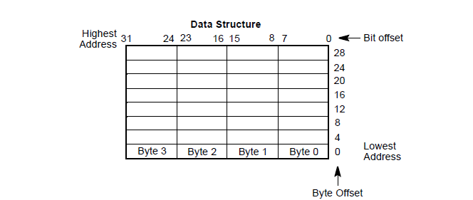
x86 Characteristics
Variable length instructions: 1-15 bytes
Can address memory directly in most instructions
Uses Little-Endian format

Slide 30
Instruction Format
General format:
opcode operands
Opcode:
Short mnemonic for instruction’s purpose
movb,addl, etc.
Operands:
Immediate, register, or memory
Number of operands command-dependent
Example:
movl %ebx, (%ecx)

Slide 31
Machine Representation
Remember, each assembly instruction translated to a sequence of 1-15 bytes
First byte holds the binary representation of the opcode
Second byte specifies the addressing mode
The type of operands (registers or register and memory)
How to interpret the operands
Some instructions can be single-byte because operands and addressing mode are implicitly specified by the instruction
E.g., pushl
opcode byte
addressing mode byte
other bytes

